Slide 1


Understanding and Modeling On-Die Error Correction in Modern DRAM: An Experimental Study Using Real Devices
Minesh Patel Jeremie S. Kim
Hasan Hassan Onur Mutlu
Notes:
Thank you for the introduction.
Today I’m going to talk about our work: Understanding and Modeling On-Die Error Correction in Modern DRAM.
This work was done by researchers from the SAFARI group at ETH Zurich.
[END]

Slide 2
Executive Summary
Motivation: Experimentally studying DRAM error mechanisms provides insights for improving performance, energy, and reliability
Problem: on-die error correction (ECC) makes studying errors difficult
Distorts true error distributions with unstandardized, invisible ECC functions
Post-correction errors lack the insights we seek from pre-correction errors
Goal: Recover the pre-correction information masked by on-die ECC
Key Contributions:
Error INference (EIN): statistical inference methodology that:
Infers the ECC scheme (i.e., type, word length, strength)
Infers the pre-correction error characteristics beneath the on-die ECC mechanism
Works without any hardware intrusion or insight into the ECC mechanism
EINSim: open-source tool for using EIN with real DRAM devices
Available at: https://github.com/CMU-SAFARI/EINSim
Experimental demonstration: using 314 LPDDR4 devices
EIN infers (i) the on-die ECC scheme and (ii) pre-correction error characteristics
We hope EIN and EINSim enable many valuable studies going forward
Notes:
First, I’ll give a high level overview of the talk.
…
[END]

Slide 3
Presentation Outline
Error Characterization and On-Die ECC
EIN: Error INference
The Inference Problem
Formalization
EIN in Practice: EINSim
Demonstration Using LPDDR4 Devices
Notes:
I’ll start out by giving some background on error characterization and on-die ECC
…
[END]

Slide 4
What is DRAM Error Characterization?
Studying how DRAM behaves
when we deliberately induce bit-flips
+
CPU
-
Operating Timing Constraints
Error Mechanisms
& Technology Scaling
System-Level
Interactions
Environmental
Effects
Understanding
Exploitable Insights
+
Notes:
So what exactly is DRAM characterization?
In a nutshell, it's the process of studying how DRAM behaves when we deliberately induce bit-flips.
We might study things like:
operating timings across different values
error mechanisms and how they scale across different technologies
interactions between CPU and the DRAM
even environmental effects such as temperature and voltage
Our hope is that by studying all these different things we can gain some understanding as to how DRAM works and get exploitable insights we can use to improve the system

Slide 5

How Do We Characterize DRAM?
DRAM Device
Test Routine
Write data
Induce errors
Read data
Record errors
Tester
e.g., CPU, FPGA
Error Distributions
Spatial Distributions
Temporal Distributions
Cell-to-cell Variation
Device Comparisons

Slide 6
Why Study DRAM Errors?
Errors provide insight into how a DRAM device works
Error mechanisms are based on physical phenomena
Patterns in errors can indicate opportunity for improvement
e.g., Reliably reducing
conservative operating timings
e.g., Efficiently profiling for
and mitigating errors
Performance
Reliability
Characterization-Driven Insights
Energy
Security
e.g., Reducing the cost
of refresh and other operations
e.g., Defending against
vulnerabilities (e.g., RowHammer)

Slide 7
Three Key Types of DRAM
No ECC
(Standard)
Rank-Level ECC
(Server-style)
On-Die ECC
(or Integrated ECC)
Data
Corrected Data
Data
Data
ECC Data
ECC
Logic
Tester
Tester
Tester
ECC Logic
ECC Logic
Raw Data Is Unmodified
Raw Data Is Unmodified
ECC Modifies Raw Data
Notes:
Chips have internal logic that can correct a limited number of errors

Slide 8
Three Key Types of DRAM
No ECC
(Standard)
Rank-Level ECC
(Server-style)
On-Die ECC
(or Integrated ECC)
Unfortunately, the on-die ECC scheme:
Cannot be bypassed
Is unknown and proprietary
Is completely invisible
Data
Corrected Data
Data
Data
ECC Data
ECC
Logic
Tester
Tester
Tester
ECC Logic
ECC Logic
Raw Data Is Unmodified
Raw Data Is Unmodified
ECC Modifies Raw Data

Slide 9
ECC Complicates Error Characterization
Original Data
1111
Scheme A
Scheme B
Scheme C
Encoder A
Encoder B
Encoder C
1111001
0001100
0111011
1011011
0101110
0011001
Decoder A (SEC)
Decoder B (SEC)
Decoder C (SEC)
1011
1111
1010
1 Error
0 Errors
2 Errors

Slide 10
ECC Complicates Error Characterization
Original Data
1111
Scheme A
Scheme B
Scheme C
Encoder A
Encoder B
Encoder C
Observed errors can change
depending on the ECC scheme
1111001
0001100
0111011
1011011
0101110
0011001
Decoder A (SEC)
Decoder B (SEC)
Decoder C (SEC)
1011
1111
1010
1 Error
0 Errors
2 Errors

Slide 11
ECC Makes Error Characterization Difficult
Unknown
ECC Scheme A
Unknown
ECC Scheme B
Pre-ECC Error Distribution
Unknown
ECC Scheme C
Based on a physical
DRAM error mechanism
ECC-scheme specific;
Error mechanism influence lost
Post-ECC Error Distribution
ECC causes two key problems:
Prevents comparing error characteristics between devices
Obfuscates the well-studied error distributions we expect

Slide 12
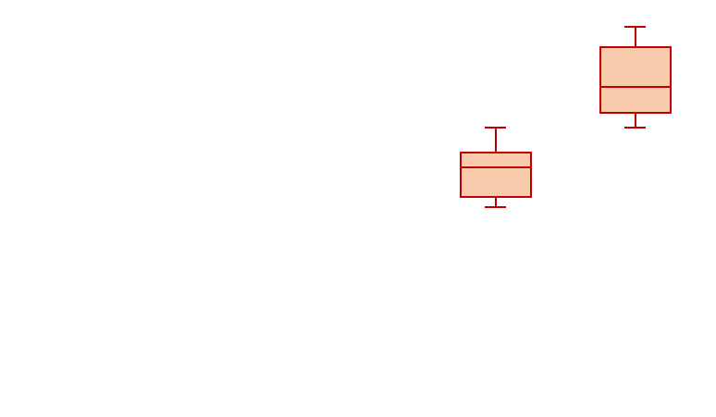

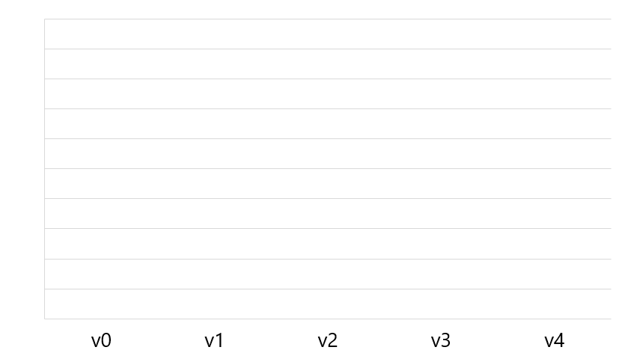
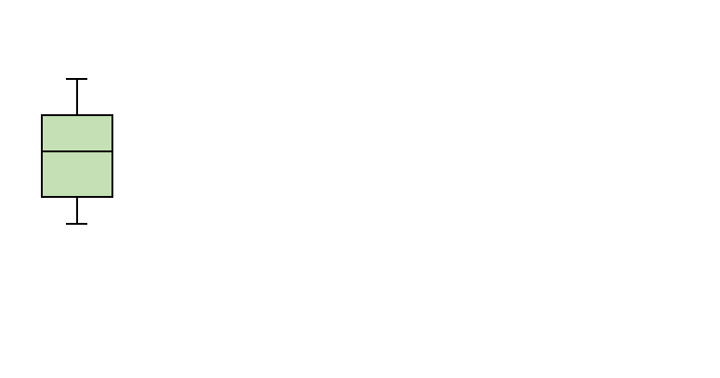
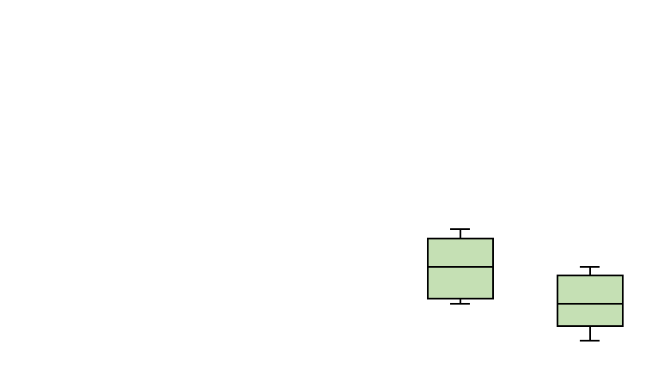
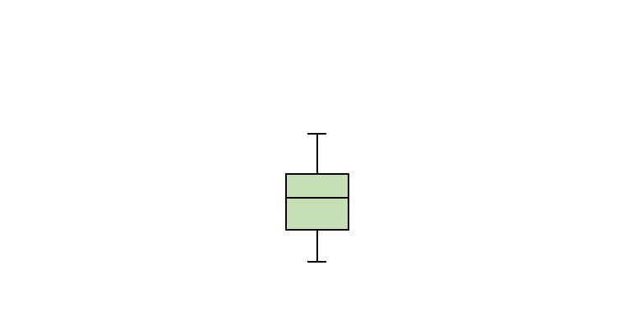
Example: Technology Scaling Study
Goal: study how errors evolve over technology generations
1.0
Post-ECC error distributions
0.8
Distribution of
all bit-errors
ECC artifact
0.6
Test Parameter Value
(e.g., temperature, voltage)
EIN
0.4
0.2
Consistent with a physical phenomenon
(e.g., process scaling)
0.0
Pre-ECC error distributions
Technology Generation

Slide 13
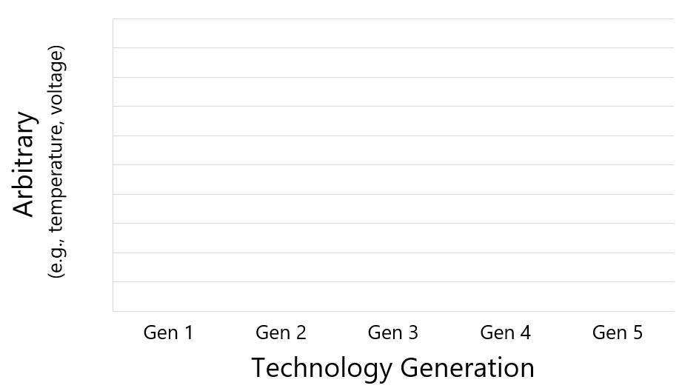
Example: Technology Scaling Study
Goal: study how errors evolve over technology generations
1.0
Post-ECC error distributions
0.8
Distribution of
all bit-errors
ECC artifact
0.6
Our goal:
Recover pre-correction error characteristics
obfuscated by on-die ECC
EIN
0.4
0.2
Consistent with a physical phenomenon
(e.g., process scaling)
0.0
Pre-ECC error distributions
Notes:
As researchers, EIN enables us to study the pre-correction error characteristics rather than being limited to just those observed post-correction. This allows us to propose better solutions from the bottom up rather than building solely upon what the manufacturer has decided to do for a particular device.

Slide 14
Presentation Outline
Error Characterization and On-Die ECC
EIN: Error INference
The Inference Problem
Formalization
EIN in Practice: EINSim
Demonstration Using LPDDR4 Devices
Notes:
I’ll start out by giving some background on error characterization and on-die ECC
…
[END]

Slide 15
Key Observation
DRAM error mechanisms have
predictable characteristics
that are intrinsic to DRAM technology

Slide 16
Example: Data-Retention Errors
REF
DRAM encodes data
in leaky capacitors
Leakage rates differ due to process variation
Necessitates periodic refresh operations
By disabling refresh, we induce data-retention errors
Well-studied and fundamental to DRAM technology
Errors exhibit predictable statistical characteristics
Exponential bit-error rate (BER) with respect to temperature
Uniform-random spatial distribution

Slide 17



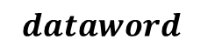
Inferring the ECC Scheme
Exploit error characteristics to infer the ECC scheme
Works for any DRAM susceptible to the error mechanism
Independent of any particular device or manufacturer
CPU
DRAM
$$dataword$$
ECC Encoder
$$codeword$$
Data Store
Inferable
Observable
Predictable
ECC Decoder
$$dataword′$$
$$codeword′$$

Slide 18
Inferring the ECC Scheme
Exploit error characteristics to infer the ECC scheme
Works for any DRAM susceptible to the error mechanism
Independent of any particular device or manufacturer
CPU
DRAM
EIN’s key idea: use predictable
error characteristics to infer:
the ECC scheme
the pre-correction error rate
$$dataword$$
ECC Encoder
$$codeword$$
Data Store
Inferable
Observable
Predictable
ECC Decoder
$$dataword′$$
$$codeword′$$

Slide 19
Presentation Outline
Error Characterization and On-Die ECC
EIN: Error INference
The Inference Problem
Formalization
EIN in Practice: EINSim
Demonstration Using LPDDR4 Devices

Slide 20







Formalizing the Inference Problem
Random variables
$$θ$$
CPU
DRAM
$$dataword \text{←} w$$
ECC Scheme $(S)$
$$codeword$$
Data Store
$$dataword^{′} \text{←} w′$$
$$codeword′$$
Model the entire DRAM transformation as a function:
Distribution
of inputs
ECC Scheme
Distribution
of outputs
Error Distribution
$$w′= f\left(w \right| S, θ)$$
We want to infer $\{S, θ\}$ given observed $\{w,w′\}$

Slide 21
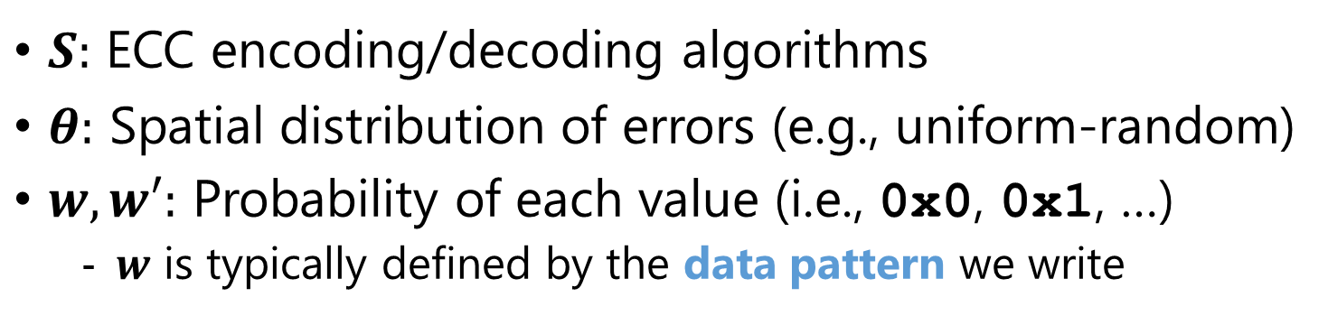

Formalizing the Inference Problem
$$θ$$
CPU
DRAM
$$dataword \text{←} w$$
ECC Scheme $(S)$
$$codeword$$
Data Store
$$dataword^{′} \text{←} w′$$
$$codeword′$$
$$w′= f\left(w \right| S, θ)$$
$S:$ ECC encoding/decoding algorithms
$θ:$ Spatial distribution of errors (e.g., uniform-random)
$w,w′:$ Probability of each value (i.e., 0x0, 0x1, …)
$w$ is typically defined by the data pattern we write

Slide 22
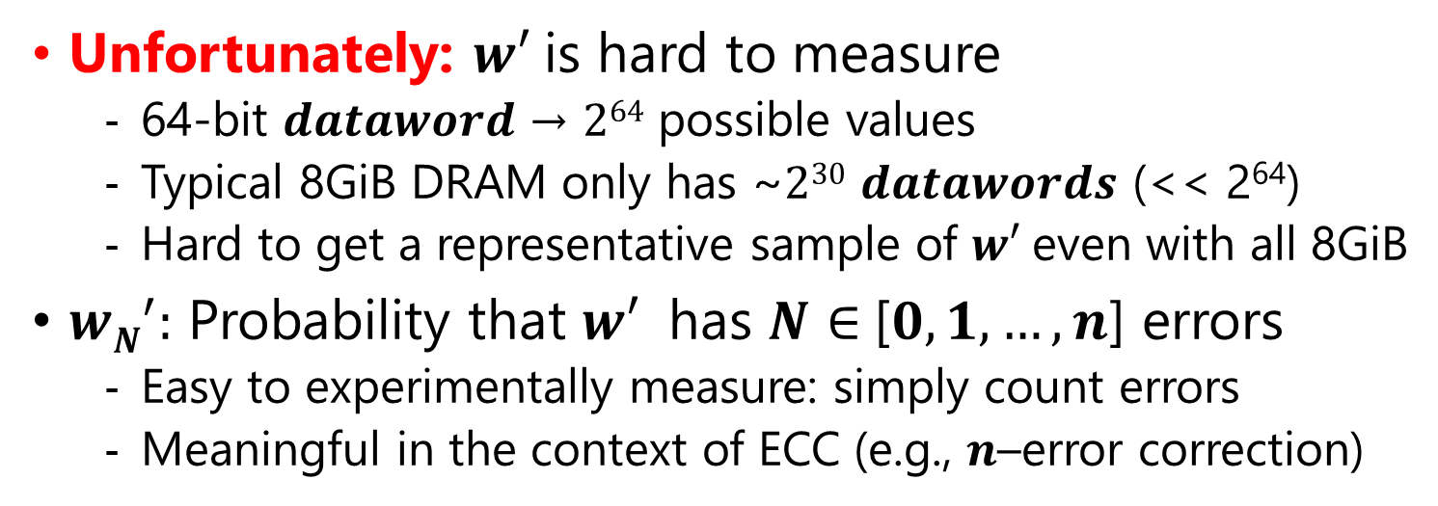
Formalizing the Inference Problem
$$θ$$
CPU
DRAM
$$dataword \text{←} w$$
ECC Scheme $(S)$
$$codeword$$
Data Store
$$dataword^{′} \text{←} w′$$
$$codeword′$$
$$w′= f\left(w \right| S, θ)$$
Unfortunately: $w′$is hard to measure
64-bit $dataword$→ $264$ possible values
Typical 8GiB DRAM only has ~$230$ $datawords$ (<< 2⁶⁴)
Hard to get a representative sample of $w′$even with all 8GiB
${wN}^{′}:$ Probability that $w′$ has $N∈$[$0, 1, …, n$] errors
Easy to experimentally measure: simply count errors
Meaningful in the context of ECC (e.g., $n$–error correction)

Slide 23
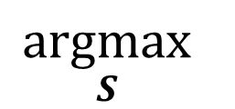
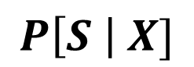
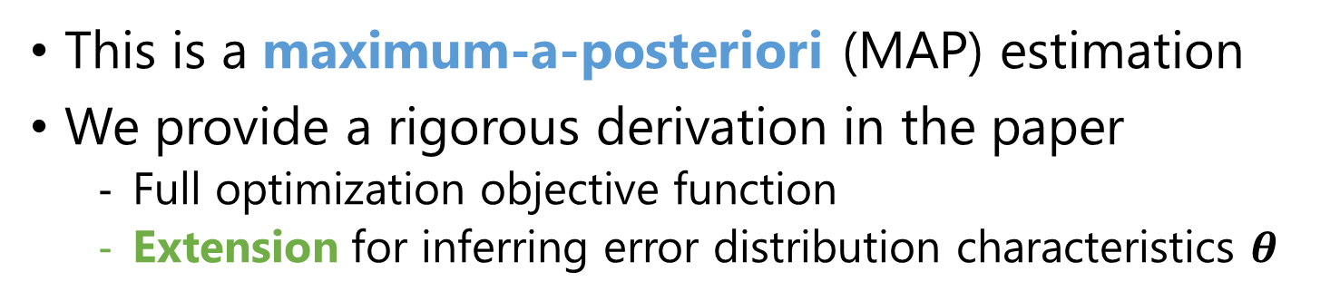
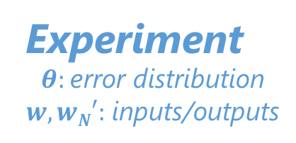

Inferring the ECC Scheme
Want the most likely ECC scheme given an experiment
Experiment
$θ:$ error distribution
$w,wN′:$ inputs/outputs
ECC Scheme
$$\underset{S}{argmax}{ }$$
$$P\left[S \right| X]$$
Bayes’
Theorem
$$\underset{S}{argmax}{P\left[X \right| S]∗P[S]}$$
Likelihood
Are these results reasonable?
Prior
How likely is S?
This is a maximum-a-posteriori (MAP) estimation
We provide a rigorous derivation in the paper
Full optimization objective function
Extension for inferring error distribution characteristics $θ$

Slide 24
Error INference (EIN) Methodology
1
Define experimental inputs
(i.e., data pattern, error mechanism)
2
Identify candidate ECC Schemes
3
Run Experiments
4
Compute MAP estimation
Most likely ECC scheme

Slide 25
Presentation Outline
Error Characterization and On-Die ECC
EIN: Error INference
The Inference Problem
Formalization
EIN in Practice: EINSim
Demonstration Using LPDDR4 Devices

Slide 26
MAP Estimation in Practice
1
Input
(i.e., data pattern,
error distribution)
2
3
Device to Test
(unknown ECC scheme)
Suspected
ECC Schemes
{A, B, C, D, …}
Monte-Carlo
Simulation
(EINSim)
Hard to calculate
analytically
Calculation
Most Likely
ECC Scheme
Experiment
4
Outputs
(# errors per word)
Observations
(# errors per word)
Likelihood per Scheme

Slide 27
EINSim: A Tool for Using EIN
Evaluates MAP estimation via Monte-Carlo simulation
Simulates the life of a dataword through a real experiment
Configuration knobs to replicate the experimental setup
Flexible and extensible to apply to a wide variety of:
DRAM devices
Error mechanisms
ECC schemes
Open-source C++/Python project
https://github.com/CMU-SAFARI/EINSim
Example datasets provided (same as used in paper)

Slide 28
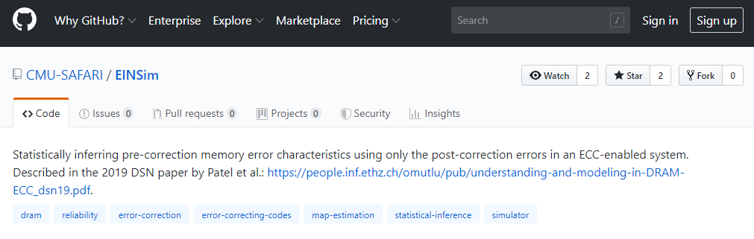
EINSim: A Tool for Using EIN
Evaluates MAP estimation via Monte-Carlo simulation
Simulates the life of a dataword through a real experiment
Configuration knobs to replicate the experimental setup
Flexible and configurable to apply to a wide variety of:
DRAM devices
Error mechanisms
ECC schemes
Give EINSim a try at:
https://github.com/CMU-SAFARI/EINSim
Open-source C++/Python project
https://github.com/CMU-SAFARI/EINSim
Example datasets provided (same as used in paper)

Slide 29
Presentation Outline
Error Characterization and On-Die ECC
EIN: Error INference
The Inference Problem
Formalization
EIN in Practice: EINSim
Demonstration Using LPDDR4 Devices

Slide 30
Methodology
We experimentally test LPDDR4 DRAM devices
232 with on-die ECC (one major manufacturer)
82 without on-die ECC (three major manufacturers)
Thermally controlled testing chamber
55ºC - 70ºC
Tolerance of ±1ºC
Precise control over the commands sent to DRAM
Ability to enable/disable self-/auto-refresh
Control over CAS (i.e., read/write) commands

Slide 31
Experimental Design
Goal: infer which ECC scheme is used
in real LPDDR4 devices with on-die ECC
Parameter | Experiment | Simulation (EINSim)
Word Size | 256 bits | 256 bits
ECC Schemes | Unknown | Hamming (32, 64, 128, 256) BCH-2EC (32, 64, 128, 256) BCH-3EC (32, 64, 128, 256) Repetition (3, 5, 7)
Data Pattern | RANDOM | RANDOM, 0xFF
Error Mechanism | Data-Retention | Data-Retention

Slide 32
MAP Estimation Methodology
Assume a uniform prior distribution
Avoids biasing results towards our preconceptions
Demonstrates EIN in the worst case
Simulate 10⁶ 256-bit words per ECC scheme
Error estimation using bootstrapping (10⁴ samples)

Slide 33
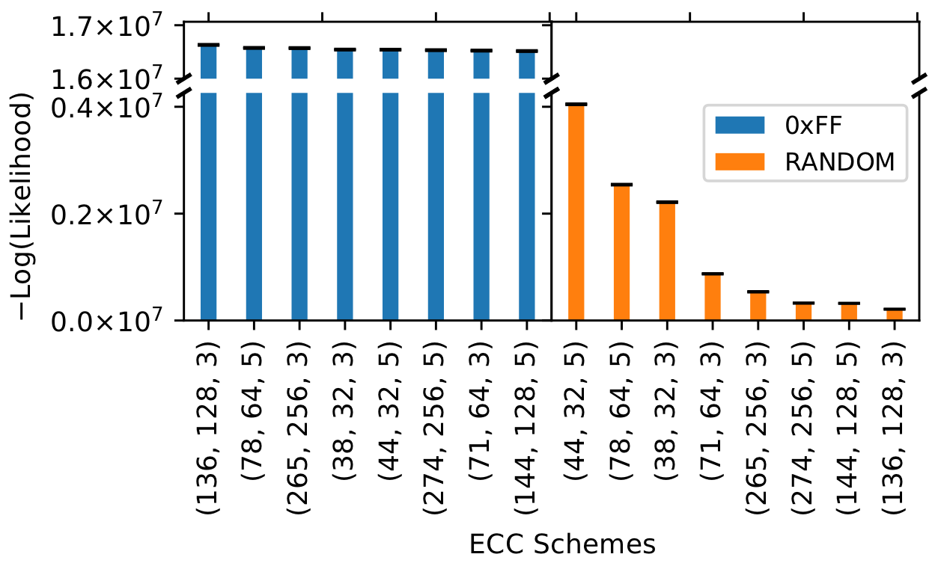
MAP Estimation Results
Lower is
MORE Likely
Confidence interval is extremely tight
Most Likely
ECC Scheme
BCH(44, 32, 2)
Ham(38, 32, 1)
BCH(78, 64, 2)
Ham(71, 64, 1)
BCH(144, 128, 2)
BCH(274, 256, 2)
Ham(265, 256, 1)
Ham(136, 128, 1)
ECC Schemes
(#code bits, #data bits, #errors correctable)

Slide 34
MAP Estimation Results
Lower is
MORE Likely
Confidence interval is extremely tight
Most Likely
ECC Scheme
Less Likely Models
BCH(44, 32, 2)
Ham(38, 32, 1)
BCH(78, 64, 2)
Ham(71, 64, 1)
BCH(144, 128, 2)
BCH(274, 256, 2)
Ham(265, 256, 1)
Ham(136, 128, 1)
ECC Schemes
(#code bits, #data bits, #errors correctable)

Slide 35
MAP Estimation Results
Lower is
MORE Likely
Confidence interval is extremely tight
EIN effectively infers the ECC scheme in LPDDR4 devices with on-die ECC
to be a (128 + 8) Hamming Code
Most Likely
ECC Scheme
EIN infers the ECC scheme without:
Visibility into the ECC mechanism
Disabling ECC
Tampering with the hardware
Less Likely Models
BCH(44, 32, 2)
Ham(38, 32, 1)
BCH(78, 64, 2)
Ham(71, 64, 1)
BCH(144, 128, 2)
BCH(274, 256, 2)
Ham(265, 256, 1)
Ham(136, 128, 1)
ECC Schemes
(#code bits, #data bits, #errors correctable)

Slide 36
EIN Applies Beyond On-Die ECC
EIN technically applies for any device for which:
Communication channel protected by ECC
Can induce uncorrectable errors
Errors follow predictable statistical characteristics
DRAM Rank-Level ECC
Flash Memory ECC
NAND
Flash
Normal
Data
ECC
Data
CPU

Slide 37
Other Contributions in our Paper
Two error-characterization studies showing EIN’s value
EIN enables comparing BERs of the DRAM technology itself
EIN recovers expected distributions that ECC obfuscates
Using EIN to infer additional information:
The data pattern written to DRAM
The pre-correction error characteristics (e.g., pre-ECC BER)
Formal derivation of EIN + discussion of its limitations
Verify uniform-randomly spaced data-retention errors
Reverse-engineering DRAM design characteristics that affect uniformness (e.g., true-/anti-cell layout)

Slide 38
Talk & Paper Recap
Motivation: Experimentally studying DRAM error mechanisms provides insights for improving performance, energy, and reliability
Problem: on-die error correction (ECC) makes studying errors difficult
Distorts true error distributions with unstandardized, invisible ECC functions
Post-correction errors lack the insights we seek from pre-correction errors
Goal: Recover the pre-correction information masked by on-die ECC
Key Contributions:
Error INference (EIN): statistical inference methodology that:
Infers the ECC scheme (i.e., type, word length, strength)
Infers the pre-correction error characteristics beneath the on-die ECC mechanism
Works without any hardware intrusion or insight into the ECC mechanism
EINSim: open-source tool for using EIN with real DRAM devices
Available at: https://github.com/CMU-SAFARI/EINSim
Experimental demonstration: using 314 LPDDR4 devices
EIN infers (i) the on-die ECC scheme and (ii) pre-correction error characteristics
We hope EIN and EINSim enable many valuable studies going forward

Slide 39
Understanding and Modeling On-Die Error Correction in Modern DRAM: An Experimental Study Using Real Devices
Minesh Patel Jeremie S. Kim
Hasan Hassan Onur Mutlu

Slide 40
Backup Slides

Slide 41
EIN: 3 Concrete Use Cases
Rapid error profiling using statistical distributions
Use properties of the error mechanisms to model errors
Use EIN to determine model parameters at runtime
Replacement for laborious, per-device characterization
Comparison studies (e.g., technology scaling)
Use EIN to compare pre-correction error rates
Study + predict industry and future technology trends
Reverse-engineering proprietary ECC schemes
Applies beyond just DRAM with on-die ECC
Can be useful for security research
E.g., vulnerability evaluation, patent infringement, competitive analysis, forensic analysis

Slide 42
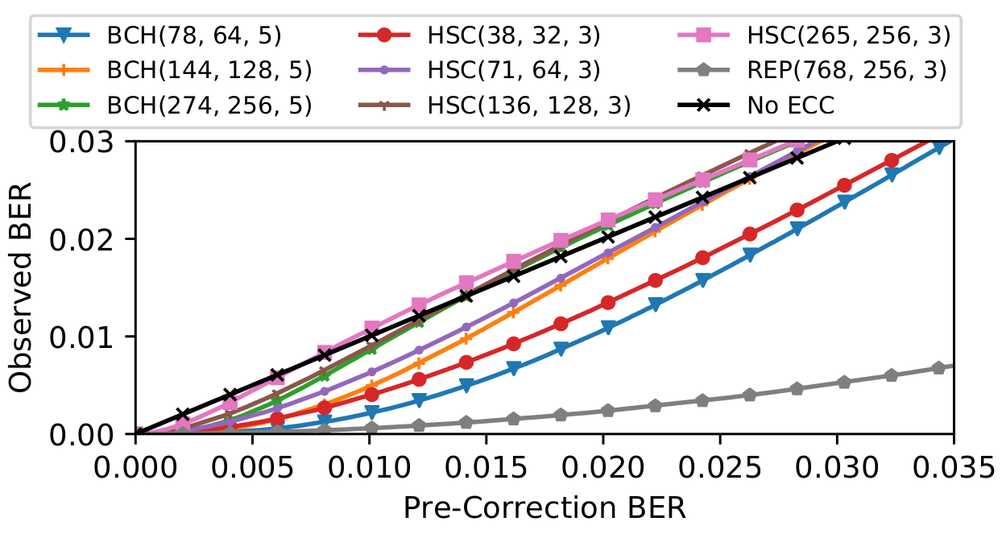

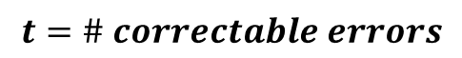
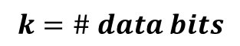
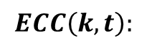
Observed BER Depends on ECC
Assume errors occur independently, uniform-randomly
Fixed per-bit $P\left[error\right]$ = “bit error rate” (BER)
BCH(64, 2)
Hamming(32, 1)
Hamming(256, 1)
BCH(128, 2)
Hamming(64, 1)
3-Repetition
BCH(256, 2)
Hamming(128, 1)
None
$$ECC\left(k, t\right):$$
$$k=\# data bits$$
$$t=\# correctable errors$$

Slide 43
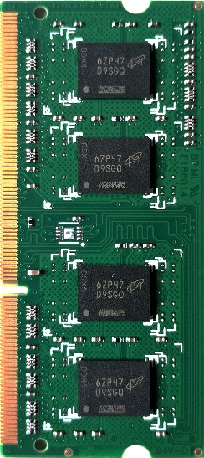
A Closer Look at On-Die ECC
DRAM with on-die ECC
Input
(writes)
ECC Encoder
Data Storage
Output
(reads)
ECC Decoder
ECC Storage
Primarily mitigates technology scaling issues [1]
Transparently mitigates random single-bit errors (e.g., VRT)
Fully backwards compatible (no changes to DDRx interface)
Unfortunately, has side-effects for error characterization
Unspecified, black-box implementation
Obfuscates errors in an ECC-specific manner
[1] “ECC Brings Reliability and Power Efficiency to Mobile Devices,” Micron Technology, Inc, Whitepaper, 2017

Slide 44
On-Die ECC in Literature
Two types of ECC mentioned
(128 + 8) Hamming code
(64 + 7) Hamming code
Paper contains references to both of these

Slide 45
On-Die ECC Research Challenge
Good for DRAM manufacturers:
✓ Transparently improves reliability
✓ Decreases power required for data retention
✓ Low latency/power overhead
✓ No changes to DRAM interface (i.e., backwards compatible)
Bad for researchers studying DRAM errors:
✘ Hides errors in a black-box, device-specific way
✘ Distorts well-understood statistical distributions
✘ Prevents fairly comparing BER of the DRAM itself

Slide 46
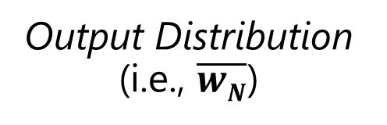
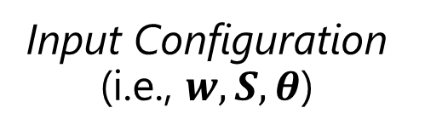
EINSim Functional Description
Simulates the dataflow through a real experiment
Configuration parameters replicate experimental setup
Simulate enough words to resolve the output distribution
Tester
DRAM
Input Configuration
(i.e., $w,S, θ$)
Word Generator
ECC Encoder
Error Injector
Output Distribution
(i.e., $\overline{wN}$)
Error Checker
ECC Decoder

Slide 47
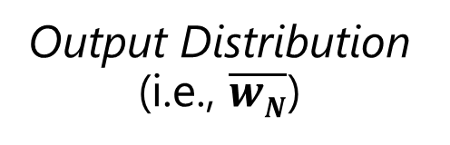
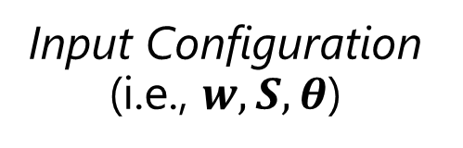
EINSim Configuration + Features
Input Configuration
(i.e., $w,S, θ$)
Word Generator
ECC Encoder
Error Injector
Output Distribution
(i.e., $\overline{wN}$)
Error Checker
ECC Decoder
Module | Parameters
Word Generator | Word length Data Pattern
ECC Encoder, ECC Decoder | ECC code {type, length, strength} code details (e.g., generator polynomial)
Error Injector | Spatial error distribution
Error Checker | Measurement (e.g., #errors per word)

Slide 48
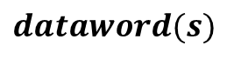
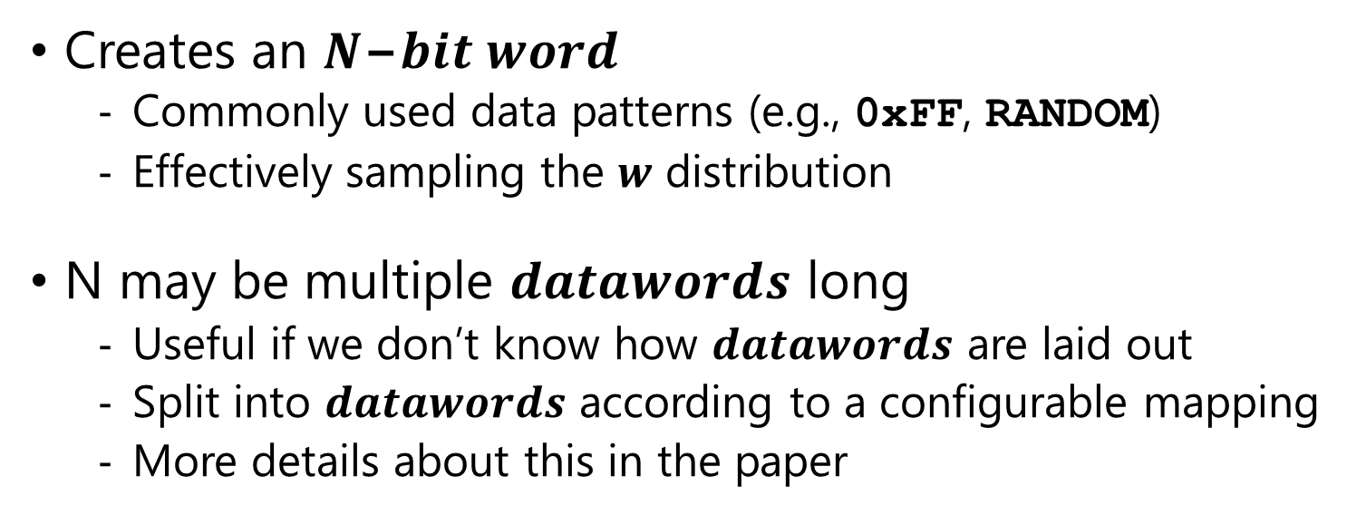
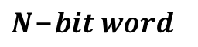
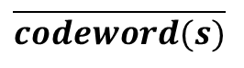
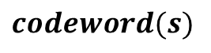
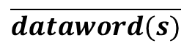
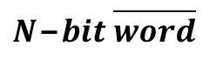
Word Generator
$$N\text{−}bit word$$
$$codeword(s)$$
Word Generator
ECC Encoder
Error Injector
$$dataword(s)$$
$$N\text{−}bit \overline{word}$$
$$\overline{codeword(s)}$$
Error Checker
ECC Decoder
$$\overline{dataword(s)}$$
Creates an $N\text{−}bit word$
Commonly used data patterns (e.g., 0xFF, RANDOM)
Effectively sampling the $w$ distribution
N may be multiple $datawords$ long
Useful if we don’t know how $datawords$ are laid out
Split into $datawords$ according to a configurable mapping
More details about this in the paper

Slide 49
ECC Encoder/Decoder
$$N\text{−}bit word$$
$$codeword(s)$$
Word Generator
ECC Encoder
Error Injector
$$dataword(s)$$
$$N\text{−}bit \overline{word}$$
$$\overline{codeword(s)}$$
Error Checker
ECC Decoder
$$\overline{dataword(s)}$$
EINSim implements ECC algorithms
Currently supports common codes (e.g., Hamming, BCH)
Modularly designed and easily extensible to others
Validated by hand + using unit tests (available on GitHub)
Configurable parameters for:
Number of data bits, correction capability
Details of implementation (e.g., generator polynomials)

Slide 50
Error Injector
$$N\text{−}bit word$$
$$codeword(s)$$
Word Generator
ECC Encoder
Error Injector
$$dataword(s)$$
$$N\text{−}bit \overline{word}$$
$$\overline{codeword(s)}$$
Error Checker
ECC Decoder
$$\overline{dataword(s)}$$
Injects errors according to a spatial error distribution
Configurable parameters depend on particular distribution
Extensible to many different error distributions
Uniform-random for data-retention errors
We experimentally validate this using real LPDDR4 devices
Experiment and analysis discussed in detail in the paper

Slide 51
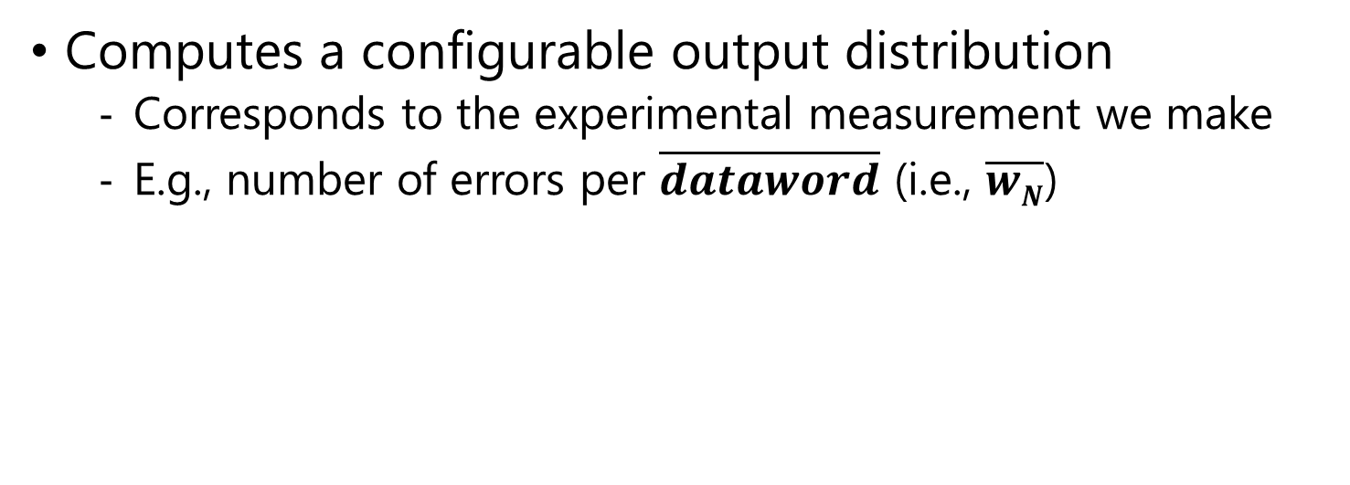
Error Checker
$$N\text{−}bit word$$
$$codeword(s)$$
Word Generator
ECC Encoder
Error Injector
$$dataword(s)$$
$$N\text{−}bit \overline{word}$$
$$\overline{codeword(s)}$$
Error Checker
ECC Decoder
$$\overline{dataword(s)}$$
Computes a configurable output distribution
Corresponds to the experimental measurement we make
E.g., number of errors per $\overline{dataword}$ (i.e., $\overline{wN}$)

Slide 52
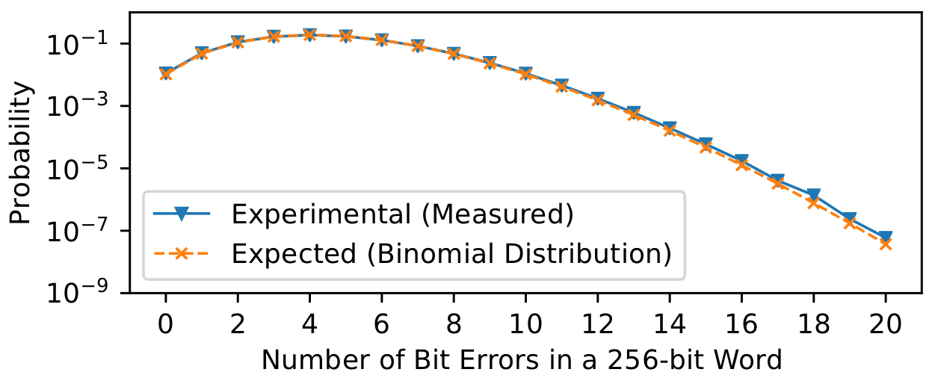
Validating Uniform-Randomness
We model data-retention errors as uniform random
Well-studied throughout prior work
Error count per N-bit word follows a binomial distribution
We experimentally validate uniform-randomness
82 LPDDR4 devices without on-die ECC
Disable refresh operations for 20s @ 60ºC

Slide 53
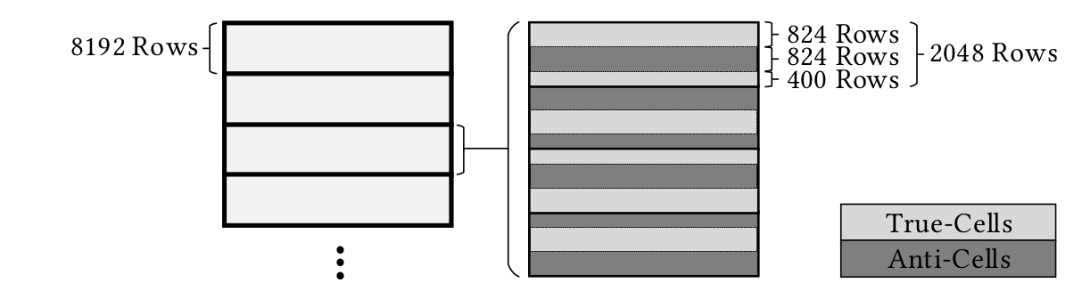
Anatomy of a DRAM Bank
DRAM cells can encode data in two ways:
Data ‘1’ as ‘charged’ -> “True-cell”
Data ‘1’ as ‘discharged’ -> “Anti-cell”
Retention errors typically “charged” -> “discharged”

Slide 54
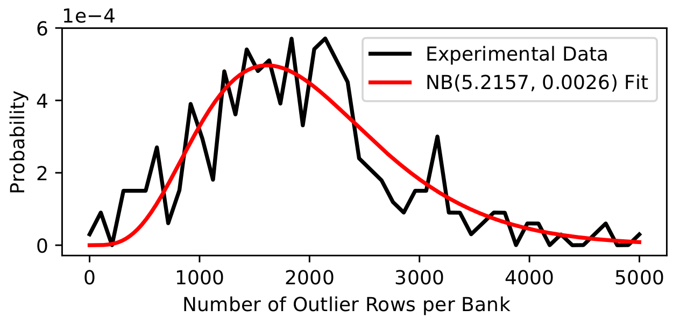
Incidence of “Outlier Rows”
Some rows do not follow the true-/anti-cell layout
Appear to follow typical “remapped row” distributions
Extra memory rows used for post-manufacturing repair

Slide 55
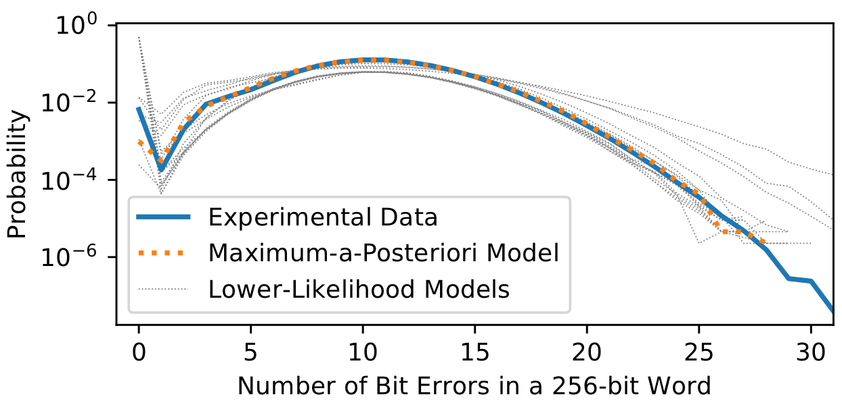
MAP Estimation Shown Graphically
Non-uniformities (details in paper)
Low sample count

Slide 56
Example Error-Characterization Studies
We provide two studies to demonstrate EIN’s value
Measure data-retention error rates
Have 314 LPDDR4 devices (with + without on-die ECC)
BER vs. refresh rates
We compare devices with on-die ECC to those without it
EIN infers the pre-correction BER beneath on-die ECC
Enables comparing BER of the DRAM technology itself
BER vs. temperature
On-die ECC distorts the expected exponential relationship
EIN recovers the obfuscated statistical distribution

Slide 57
Finding the “Right” Answer
MAP estimation selects between suspected models
EIN cannot tell if the MAP estimate is “right”
“Likelihood” is a relative measure
Techniques for gaining confidence in the answer:
Using confidence intervals (e.g., statistical bootstrap)
Testing across many different error conditions
Unlikely that the ECC scheme used is unknown
ECC is a well-studied area
Manufacturers are unlikely to a completely unknown code
Typically we may suspect some schemes already
Academic/industry papers, datasheets, etc.

Slide 58
Control of Errors
EIN requires knowledge and control of errors
Understand the spatial distribution of errors
Be able to induce uncorrectable errors
Not a limitation in practice for DRAM
Many well-studied easily-controlled error mechanisms exist
E.g., data retention
E.g., access-latency reduction (i.e., tRCD, tRP, etc.)
E.g., RowHammer

Slide 59
Error Localization
EIN cannot identify bit-exact error locations
ECC decoding function is lossy (i.e., many-to-one)
We are unaware of a way to reverse the decoding function
Not a limitation in practice since we can still infer:
The ECC scheme
Pre-correction error rates

